Slide 1
Why do we compute?
Title Month Year — Name 30pt/0.83ls Medium

Slide 2
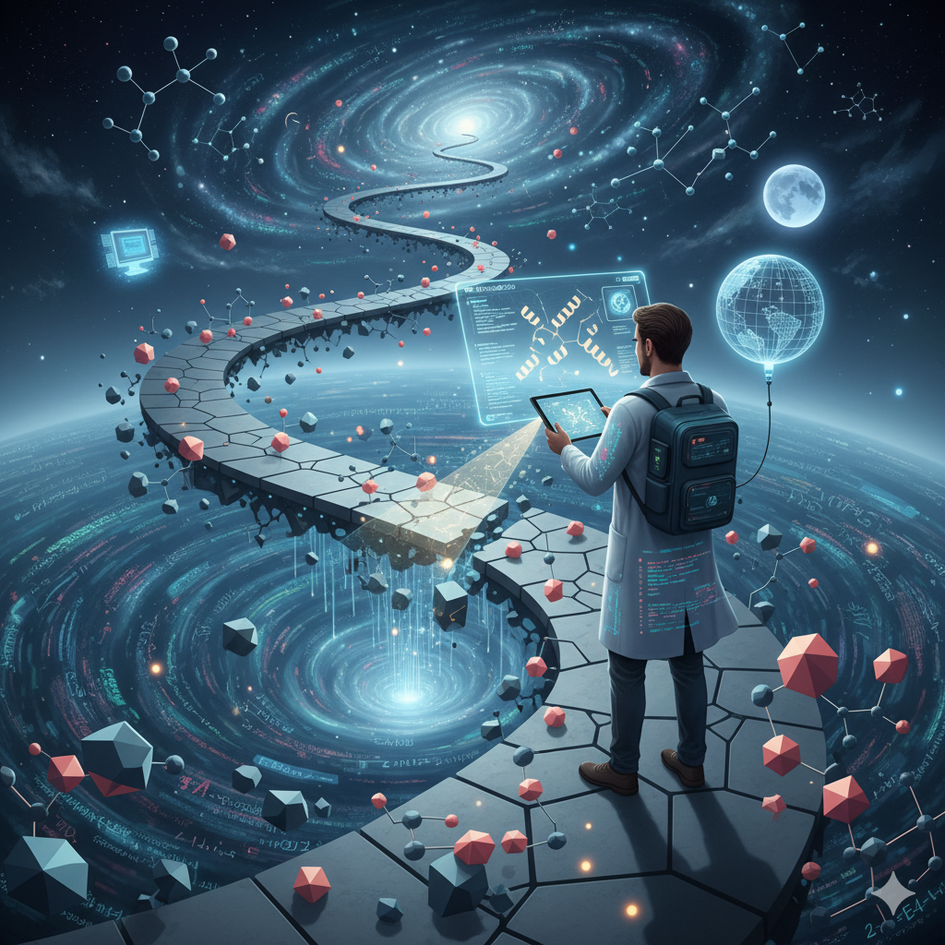
Navigating the impossible landscape
Reality is a small subset of the computational universe.
Many questions can’t be answered experimentally
Does fluorine’s electronegativity or its size increase the affinity?
Computation allows us to explore counterfactual worlds where nature’s constants can be tuned

Slide 3
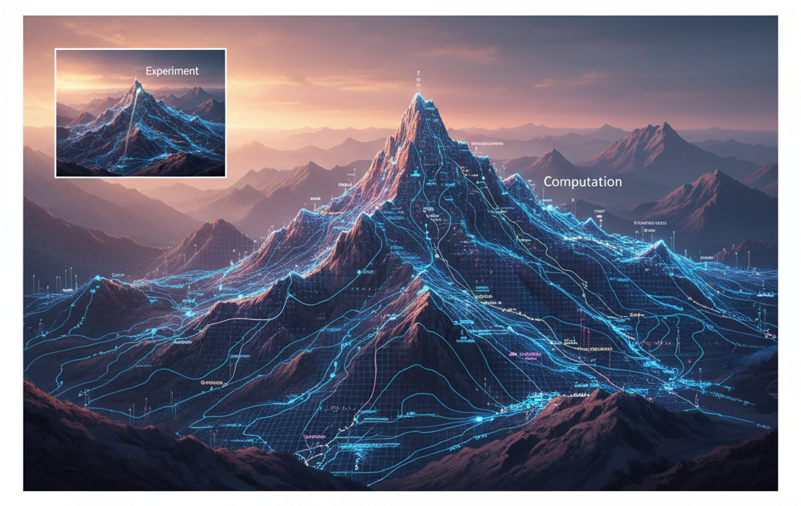
The map and the mountain
Most experiments optimize for one property e.g. affinity
Computation allows to sample the landscape of possibilities and optimize for multiple objectives simultaneously like affinity, solubility, toxicity, etc.

Slide 4
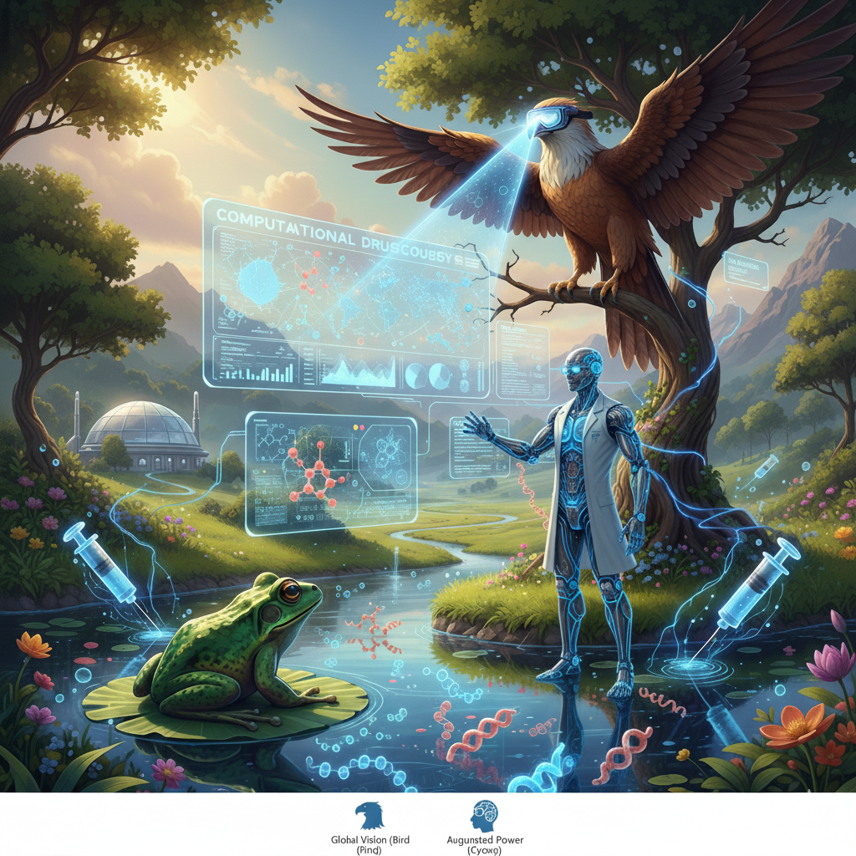
Birds, Frogs and Cyborgs
Humans are Frogs or Birds
The Birds – See the big picture, can lose the sight of the details (Einstein)
The Frogs – Explore their field with immense detail, miss the long-range connections (John von Neumann)
Computation allows us to seamlessly switch between the two perspectives
Combines the Bird’s universal rules with Frog’s detailed observations

Slide 5
Bicycle Therapeutics, Inc.
35 Cambridgepark Drive
Suite 350
Cambridge, MA 02140 USA
T. +1 617-945-8155 BicycleRD Limited
Portway Building
Granta Park, Cambridge CB21 6GS, UK T. +44 (0)1223 261503
Bicycle Therapeutics plc
Portway Building
Granta Park, Cambridge CB21 6GS, UK T. +44 (0)1223 261503
BicycleTx Limited Portway Building
Granta Park, Cambridge CB21 6GS, UK T. +44 (0)1223 261503 Bicycletherapeutics.com

